Slide 1
Experiments
Team imported
Lóránd Heidrich
Gergő Márk Sere
Gergely Terényi
Diego Caparros Vaquer
Notes:
Hello everyone. We are Team Imported. Today, I will talk about our experiments for Task 3.
I will show you how we tested different models and found the best one for this specific task.

Slide 2
How We Test Models
Goal: Test MLP, LSTM, & 1D CNN models.
Find 58 types of sounds in short audio clips (120 ms).
Data:
Data Split: 70% for Training, 10% for Validation, 20% for Testing.
How We Train:
Optimizer: Adam.
Learning Rate Adjuster: ReduceLROnPlateau (uses Validation BACC).
Epochs: 15 (for search), 30 (for best model). Batch Size: 32.
How We Measure Success:
Mean per-class Balanced Accuracy (BACC).
Good for many sound types & when some sounds are rare.
Notes:
Our main goal was to test three types of models: MLP, LSTM, and 1D CNN. We want them to find 58 different sound types in these short audio pieces.
We divided our data: most of it for training the models (70%), a small part for checking and tuning them (10%), and a final part for testing the best model (20%).
For training, we used 'Adam' to help the model learn. We also used ReduceLROnPlateau to change the learning speed if the model was not improving on the validation data. We trained for 15 cycles when searching for good settings, and 30 cycles when training our best model. We used a batch size of 32.
To see how good a model is, we used Mean per-class Balanced Accuracy or BACC. This is a good measure because we have many sound types, and some sounds appear much more often than others. BACC helps us see if the model is good for all sound types.
We also used Binary Cross-Entropy with Logits as our loss function, which helps the model learn from its mistakes.

Slide 3
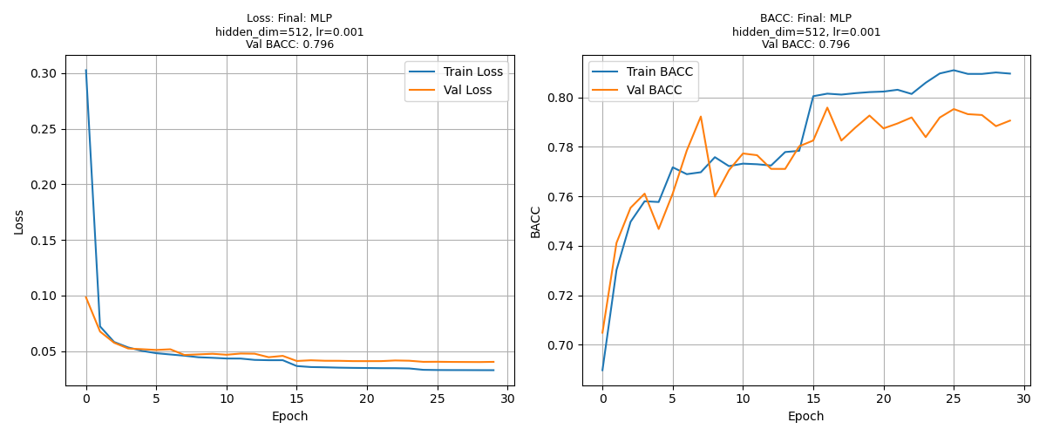
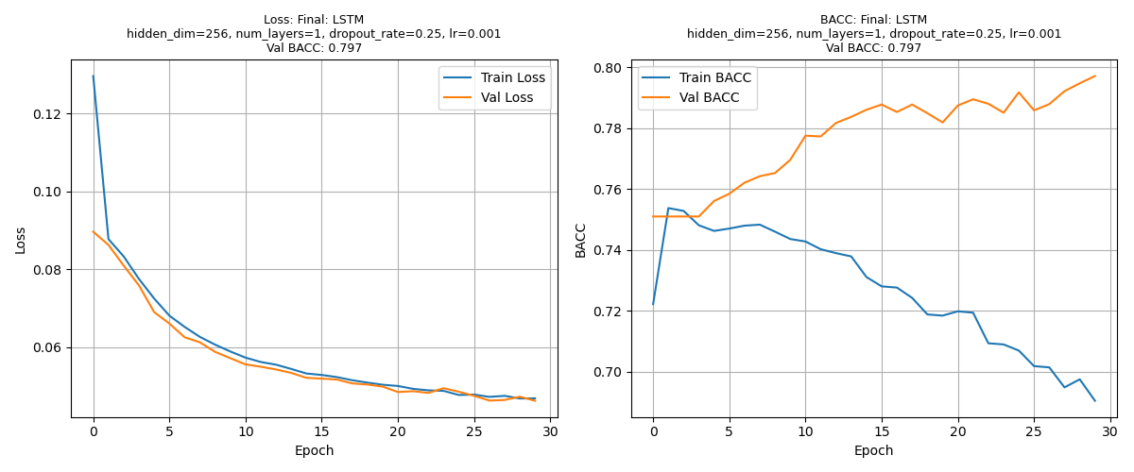
MLP & LSTM: Checking Performance
Multi-Layer Perceptron (MLP)
Simple model: 1 hidden layer.
Tested: Hidden layer size (h), learning speed (lr).
Best: Larger hidden size (h=512), lr=10⁻³.
Overfitting was okay.
Best Validation BACC (during search): 0.7934.
Long Short-Term Memory (LSTM)
Tested: Hidden size (h), layers (l), dropout (d), lr.
Many LSTMs got stuck around 0.751 Val BACC.
Best: 1 layer, h=256.
Dropout helped stop overfitting.
Best Validation BACC (during search): 0.7807.
Notes:
For the MLP model, which is a simpler type, we tested different sizes for its hidden layer and different learning speeds.
We found that a bigger hidden layer (size 512) and a learning speed of 10⁻³ worked best. Sometimes the model did much better on training data than on new (validation) data, which is overfitting, but it was not a big problem here. The best BACC score on validation data during our search was 0.7934.
For LSTMs, which can remember sequences, we tested different hidden sizes, number of layers, dropout, and learning speeds.
Many LSTM tests did not improve much beyond a BACC of 0.751. The best results came from LSTMs with one layer and a hidden size of 256.
Dropout was important for LSTMs; it helped them perform better on new data. The best BACC on validation data from our LSTM search was 0.7807.

Slide 4
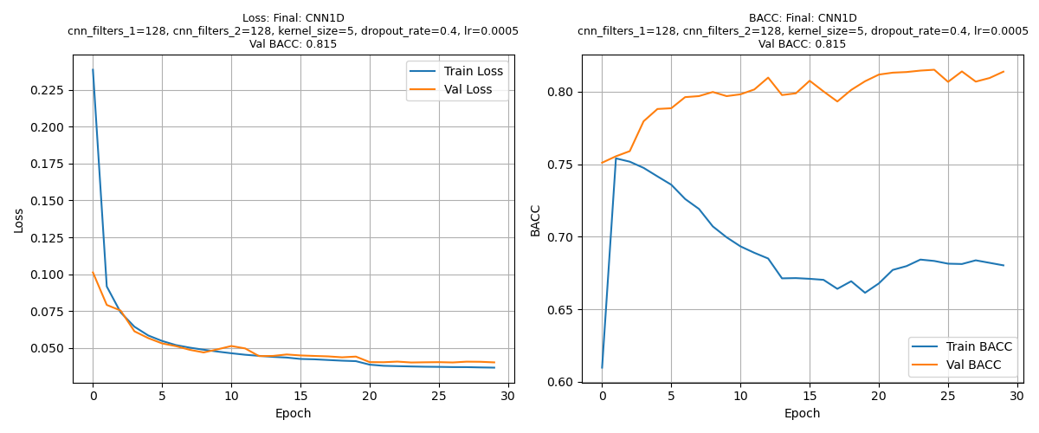
1D CNNs: Getting the Best Results
1D Convolutional Neural Network (CNN1D)
Model with two 1D CNN parts (plus BatchNorm, Dropout).
Tested: Filters (f1​,f2​), kernel size (ks∈{3,5}), dropout (d∈{0.25,0.4}), lr.
Found:
Kernel size 5 was better than 3.
More filters (e.g., f1​=128,f2​=128) & more dropout (d=0.4) were good.
Best learning speed: around 5×10⁻⁴.
Good at learning: Often Validation BACC > Training BACC (Good!).
Best Validation BACC (during search): 0.8134.
Notes:
Our CNN1D models had two main parts. We also used Batch Normalization and Dropout to help them learn better and avoid overfitting.
We tested many settings: the number of filters, the kernel size (how much of the data the model looks at once – 3 or 5), dropout amount, and learning speed.
We learned that a kernel size of 5 worked better than 3. Using more filters (like 128 in both parts) and more dropout (0.4) was also helpful. The best learning speed was usually 5×10⁻⁴.
These CNN1D models were very good at learning general things. Often, their score on new (validation) data was even better than on the training data. This is great and shows dropout worked well. For our best search, training BACC was 0.691 and validation BACC was 0.813.

Slide 5
Analysis & Our Best Model
Key Insights:
CNN1D superior (Test BACC 0.8201): Best at local patterns & good regularization.
MLP: Good simple model (Test BACC 0.8008).
LSTM: Harder to optimize here (Test BACC 0.7986).
Our Choice: CNN1D (f_1/f_2=128,ks=5,d=0.4,lr=5×10⁻⁴)
Model Family | Best Hyperparameters (Search) | Val BACC (Retrain) | Test BACC
MLP | h=512,lr=10⁻³ | 0.7960 | 0.8008
LSTM | h=256,l=1,d=0.25,lr=10⁻³ | 0.7970 | 0.7986
CNN1D | f_1/f_2=128,ks=5,d=0.4,lr=5×10⁻⁴ | 0.8151 | 0.8201
Notes:
Finally, we compared the best versions of each model type on the final test data. This data was new to all models.
This table shows the results. You can see the 'Test BACC' which is the most important score.
The 1D CNN model performed the best. It got a Test BACC of 0.8201. This means it was very good at finding sound patterns in the audio features and didn't overfit.
The MLP model was also quite good, with a Test BACC of 0.8008. It’s a good simple option.
The LSTM model was a bit harder to get good results from for this specific data. Its Test BACC was 0.7986.
So, based on all our tests, we chose the CNN1D model as the best. The settings for this model are: 128 filters in the first part, 128 filters in the second part, a kernel size of 5, a dropout of 0.4, and a learning speed of 5×10⁻⁴.

